Slide 1














NextHikes IT Solutions
Project 1
Building Basic Calculator
~ Presented by Jaspreet Kaur

Slide 2

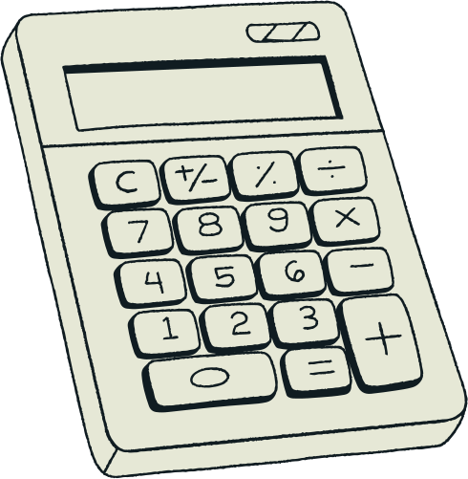
Building Basic Calculator
1.This project focuses on building a basic calculator application using PyQt, a Python library for creating graphical user interfaces (GUIs).
2.The calculator will have an equation display area, interactive buttons for numbers and operations, and essential features like addition, subtraction, multiplication, division, and clearing/reset functionality.
3.Through this project, we’ll learn the fundamentals of Python programming, GUI development, and tools like Visual Studio Code and GitHub.
4. It’s a hands-on way to explore application development while improving your coding, debugging, and design skills.

Slide 3
Understanding the Project Requirements:
Broke down the features into manageable tasks. Reviewed the basics of Python programming to ensure readiness for implementing mathematical logic.
01.
Exploration Process
Research and Setup:
Explored PyQt documentation to understand the core components. Installed PyQt (pip install PyQt5) and tested the environment by creating a basic PyQt window. Set up Visual Studio Code (VS Code) as the IDE for this project to leverage features like debugging, syntax highlighting, and extensions for Python and PyQt development.
02.
03.
Implementation:
Designed the layout of the calculator.

Slide 4
Benefits of Self-Research
01
02
03
Enhances your problem-solving skills.
Develops an independent and exploratory mindset.
Builds a strong foundation for tackling advanced projects.

Slide 5
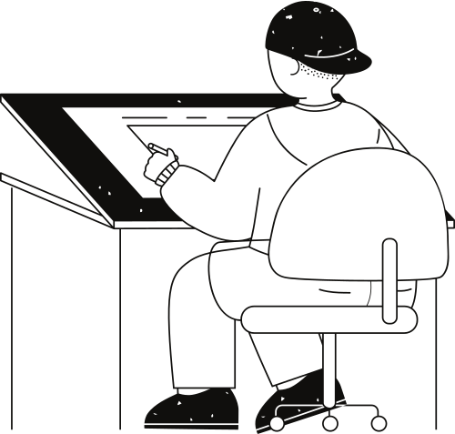

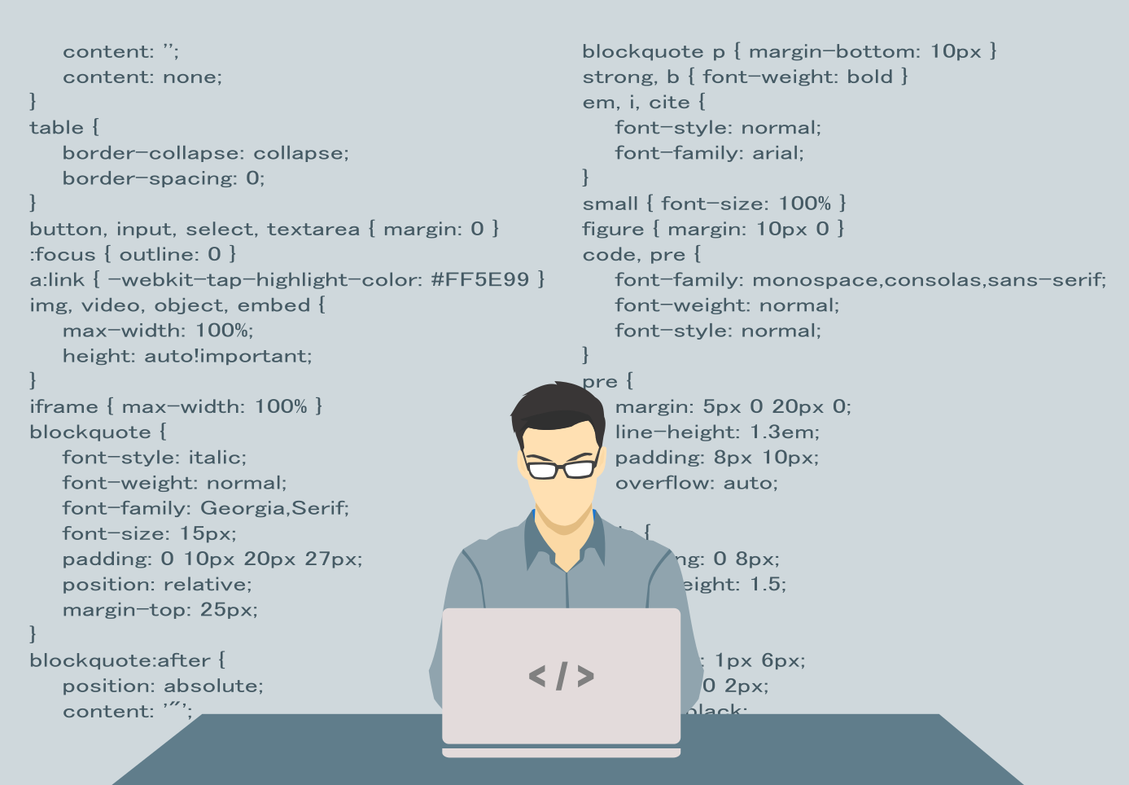

Calculator Features
Equation Display Area: Displays mathematical expressions and results.
Interactive Buttons: Numbers, operations (+, -, *, /), and essential functions.
Core Operations: Addition, subtraction, multiplication, division.
Execution and Clearing: "=" for execution and "C" for clearing.
Mind map
Learning Outcomes
Core Python Programming
PyQt Library for GUI development
Application Development using Python.
Exploring creativity
Development Tools
Visual Studio Code (IDE)
GitHub for version control.

Slide 6
REFERENCES
1. Official PyQt Documentation: https://www.riverbankcomputing.com/software/pyqt/intro
2. Python Programming Tutorials: https://docs.python.org/3/tutorial/
3. Qt Designer Tool: https://doc.qt.io/qt-5/qtdesigner-manual.html
4. GitHub Learning Resources: https://docs.github.com/en/get-started

Slide 7
Thank you very much!

